Slide 2
Chapter 16, LO1, key terms
Describe the structure and function of the gastrointestinal system
Define the following terms:
digestion
the process of preparing food physi­cally and chemically so that it can be absorbed into the cells.
elimination
the process of expelling wastes (made up of the waste products of food and flu­ids) that are not absorbed into the cells.

Slide 3
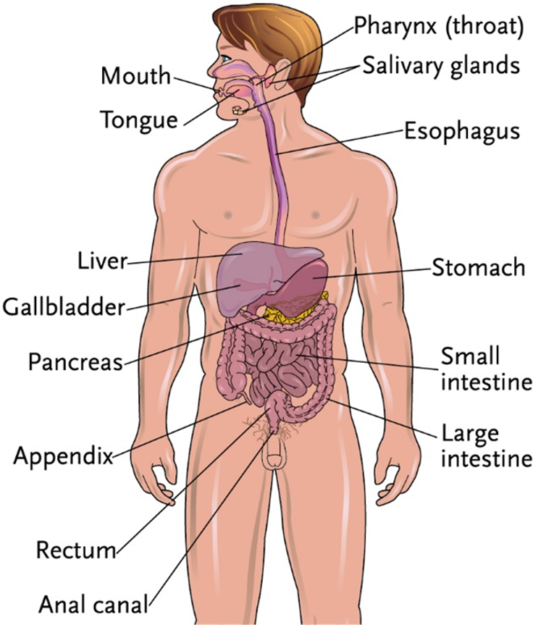
LO1, content 1
Key Material 16-1: The Gastrointestinal System

Slide 4
LO1, content 2
Describe the structure and function of the gastrointestinal system
Remember the following points about the gastrointestinal system:
Digestion is the process of preparing food for absorption into the cells
Absorption is the transfer of nutrients from the intestines to the cells
Elimination is the process of expelling wastes that are not absorbed into the cells

Slide 5
LO1, content 3
Describe the structure and function of the gastrointestinal system
Normal changes of aging include the following:
Decreased saliva production affects chewing/swallowing
Dulled sense of taste may result in poor appetite
Decreased absorption of vitamins/minerals
Longer, less efficient digestion
More frequent constipation caused by body moving more slowly through the intestines

Slide 6
LO2, key terms
Discuss common medications used to treat stomatitis and ulcerative gingivitis
Define the following terms:
stomatitis
inflammation and soreness of the mouth.
ulcerative gingivitis
an infection of the gums, usually caused by lack of proper mouth care.

Slide 7
LO2, content 1
Discuss common medications used to treat stomatitis and ulcerative gingivitis
Treatment for stomatitis includes the following:
Topical anesthetics to numb the affected area and reduce pain
Topical corticosteroids (oral for severe cases) to reduce inflammation
Antibiotic/antifungal agents if bacterial or fungal infection is diagnosed
Table on textbook p. 155 (or handout) details specific drugs

Slide 8
LO2, content 2
Discuss common medications used to treat stomatitis and ulcerative gingivitis
Treatment for ulcerative gingivitis includes the following:
Thorough cleaning performed by an oral hygienist or dentist
Regular antiseptic rinses
Oral antibiotics may be required if the infection spreads to the rest of the body
Table on textbook p. 155 (or handout) details specific drugs

Slide 9
LO2, content 3
Discuss common medications used to treat stomatitis and ulcerative gingivitis
Note these care guidelines for stomatitis and ulcerative gingivitis:
Corticosteroids can cause oral candidiasis (thrush). Residents using topical corticosteroids in the mouth must rinse with water afterward
Any sore, irritation, or inflammation in the mouth can be made worse by acidic or spicy foods. Carbonated beverages and citrus juices should also be avoided
Report poorly fitted dentures and complaints of mouth pain promptly
Dilute hydrogen peroxide as ordered before using it as a mouth rinse. Swallowing hydrogen peroxide is dangerous
Residents who are cognitively impaired may need to have topical agents applied to the surface of sores with a swab rather than a rinse (to prevent swallowing). Follow instructions on the MAR
Report any system symptoms (e.g., fever, malaise) that could indicate need for systemic antibiotic treatment

Slide 10
LO3, key terms
Discuss common medications used to treat gastroesophageal reflux disease (GERD), peptic ulcer disease, and gastritis
Define the following terms:
gastroesophageal reflux disease (GERD)
a chronic condition in which the liquid contents of the stomach back up into the esophagus.
peptic ulcer
raw sore in the stomach that can cause pain, belching, and vomiting.
gastritis
inflammation or irritation of the lining of the stomach.

Slide 11
LO3, content 1
Discuss common medications used to treat gastroesophageal reflux disease (GERD), peptic ulcer disease, and gastritis
Understand the following about treatment for gastroesophageal reflux disease (GERD):
Lifestyle and diet changes can relieve symptoms
Proton pump inhibitors slow the release of acid into the stomach
H2 blockers slow the release of acid into the stomach
Both classes of medication can cause nausea, vomiting, and headache
Long-term use of proton pump inhibitors may cause kidney injury and vitamin deficiencies
Table on textbook p. 156 (or handout) details specific drugs

Slide 12
LO3, content 2
Discuss common medications used to treat gastroesophageal reflux disease (GERD), peptic ulcer disease, and gastritis
Understand the following about treatment for peptic ulcers:
If caused by bacteria, a combination of antibiotics and a proton pump inhibitor may be ordered
If caused by reflux, medications are similar to those used for GERD
OTC antacids reduce acidity in the stomach and can relieve symptoms
Table on textbook p. 156 (or handout) details specific drugs

Slide 13
LO3, content 3
Discuss common medications used to treat gastroesophageal reflux disease (GERD), peptic ulcer disease, and gastritis
The following medications are used in the treatment for gastritis:
Proton pump inhibitors
H2 blockers
Misoprostol may be administered to prevent/treat stomach damage caused by NSAIDs
Table on textbook p. 157 (or handout) details specific drugs

Slide 14
LO3, content 4
Discuss common medications used to treat gastroesophageal reflux disease (GERD), peptic ulcer disease, and gastritis
Care guidelines for GERD, peptic ulcer disease, and gastritis include the following:
Administer proton pump inhibitors 30–60 minutes before a meal for maximum effectiveness
Some medications for these conditions take time to work. Encourage residents to be patient during this phase.
Know the foods and drinks that can increase symptoms:
Citrus fruits and beverages
Tomatoes
Chocolate
Fatty foods
Spicy foods
Caffeine
Alcohol
Large meals/lying down soon after eating

Slide 15
LO3, content 5
Discuss common medications used to treat gastroesophageal reflux disease (GERD), peptic ulcer disease, and gastritis
Care guidelines for GERD, peptic ulcer disease, and gastritis (cont’d):
Lowfat milk may relieve pain temporarily
Do not administer NSAIDs to residents with peptic ulcer disease unless ordered
For residents who are nonverbal, observe for facial expression and mood changes that may indicate pain

Slide 16
LO4, key terms
Discuss common medications used to treat nausea, vomiting, diarrhea, and gastroenteritis
Define the following terms:
nausea
the feeling that one might vomit.
vomiting
the act of ejecting stomach contents through the mouth and/or nose; also called emesis.
diarrhea
the frequent elimination of liquid or semi-liquid feces.
gastroenteritis
irritation or inflammation of the intestines.

Slide 17
LO4, content 1
Discuss common medications used to treat nausea, vomiting, diarrhea, and gastroenteritis
Treatment for nausea and vomiting includes the following:
Rehydration beverages to replace fluids and electrolytes
Antiemetics to slow or prevent vomiting (oral, transdermal, rectal, and IV formulations available)
Some antihistamines have an antinausea/antiemetic effect
Table on textbook p. 157 (or handout) details specific drugs

Slide 18
LO4, content 2
Discuss common medications used to treat nausea, vomiting, diarrhea, and gastroenteritis
Treatment for diarrhea includes the following:
Antimotility agents slow the movement of the digestive tract
Probiotics may shorten a bout of diarrhea
Table on textbook p. 157 (or handout) details specific drugs

Slide 19
LO4, content 3
Discuss common medications used to treat nausea, vomiting, diarrhea, and gastroenteritis
Understand the following about treatment for gastroenteritis:
Treated according to symptoms
Rest and hydration are key

Slide 20
LO4, content 4
Discuss common medications used to treat nausea, vomiting, diarrhea, and gastroenteritis
Care guidelines for nausea, vomiting, diarrhea, and gastroenteritis include the following:
Report signs of dehydration to the nurse immediately:
Dry mouth/lips
Sunken eyes
Dark or strong-smelling urine
Confusion
When administering oral medications, provide small sips of cold water. Sweet beverages can also ease nausea
Report immediately if a resident is unable to tolerate swallowing an oral medication or vomits immediately after taking a medication
Wash hands frequently with soap and water. Viruses that cause gastroenteritis are highly contagious. Chronic watery diarrhea may be caused by C. difficile, a spore-forming bacterium. Alcohol-based hand sanitizer is not effective against C. difficile

Slide 21
LO5, key terms
Discuss common medications used to treat constipation and hemorrhoids
Define the following terms:
constipation
the inability to eliminate stool, or the infrequent, difficult, and often painful elimi­nation of a hard, dry stool.
hemorrhoid
enlarged vein in the rectum or outside the anus that can cause rectal itching, burning, pain, and bleeding.

Slide 22
LO5, content 1
Discuss common medications used to treat constipation and hemorrhoids
Treatment for constipation includes the following:
Increasing fiber and fluid intake
Increasing activity
Laxatives to allow stool to pass more easily
Some soften the stool
Some increase the movement of the intestines
Some do both
Laxatives come in many forms; suppository or enema forms usually result in a bowel movement more quickly than oral laxatives.
Table on textbook p. 157 (or handout) details specific drugs

Slide 23
LO5, content 2
Discuss common medications used to treat constipation and hemorrhoids
Understand the following about treatment for hemorrhoids:
First line of treatment is increasing fiber/fluid intake
Topical anesthetics numb pain
Topical corticosteroids reduce inflammation
Pads, gels, creams, sprays, and suppositories may include both anesthetic and corticosteroid medications
Table on textbook pp. 157–158 (or handout) details specific drugs

Slide 24
LO5, content 3
Discuss common medications used to treat constipation and hemorrhoids
Care guidelines for constipation and hemorrhoids include the following:
Encourage physical activity and proper water and fiber intake
Discourage straining when residents are experiencing constipation. This can cause hemorrhoids or make them worse
Report to the nurse if a resident taking laxatives develops diarrhea. Do not administer a laxative to a resident diarrhea without first reporting to the nurse

Slide 25
LO6, key terms 1
Discuss common medications used to treat conditions affecting the bowels
Define the following terms:
irritable bowel syndrome (IBS)
a condition that causes diarrhea, constipation, or both on a regular basis.
inflammatory bowel disease (IBD)
a condition in which the bowel is chronically inflamed.
ulcerative colitis
a chronic inflammatory disease of the large intestine.

Slide 26
LO6, key terms 2
Discuss common medications used to treat conditions affecting the bowels
Define the following terms:
Crohn’s disease
an inflammatory disease that can affect any part of the digestive tract, but most commonly affects the small intestine.
diverticulitis
inflammation of diverticula, or small pouches that form in the colon.

Slide 27
LO6, content 1
Discuss common medications used to treat conditions affecting the bowels
Treatment for irritable bowel syndrome (IBS) includes the following:
Avoiding trigger foods/beverages
Medications depend upon symptoms
Psyllium and probiotics may help IBS with constipation
Antispasmodic agents can relax muscles in the digestive tract and improve cramping
Antidepressants may reduce symptoms
Antibiotics may be ordered for IBS with diarrhea
Table on textbook p. 158–159 (or handout) details specific drugs

Slide 28
LO6, content 2
Discuss common medications used to treat conditions affecting the bowels
Understand the following about treatment for inflammatory bowel disease (ulcerative colitis and Crohn’s disease):
Medications ease symptoms but cannot cure IBD
Corticosteroids reduce inflammation
5-aminosalicylates may also be ordered to reduce inflammation
Immunosuppressants are prescribed because immune system reactions are involved in causing IBD
Antidiarrheal/antimotility medications may be used
Iron supplements may be ordered
Table on textbook p. 159 (or handout) details specific drugs

Slide 29
LO6, content 3
Discuss common medications used to treat conditions affecting the bowels
Treatment for diverticulitis includes the following:
Oral antibiotics for mild cases
IV antibiotics/hospitalization for severe cases (because complications can be dangerous; if an infected pouch ruptures it can cause peritonitis, or infection of the abdominal cavity)
Table on textbook p. 160 (or handout) details specific drugs

Slide 30
LO6, content 4
Discuss common medications used to treat conditions affecting the bowels
Care guidelines for bowel conditions include the following:
Observe and report worsening or improvement of IBS symptoms. Treatment is most successful when triggers can be identified
Monitor for signs of infection (fever, malaise) in residents taking corticosteroids or immunosuppressants
Dietary changes can help lesson effects of bowel conditions. Smaller, more frequent meals can help control IBS. Bland foods can improve symptoms of IBD. Encourage residents to follow diet plans
Report any sign of intestinal bleeding. Report worsening of diverticulitis

Slide 31
LO7, key terms
Discuss common medications used to treat conditions affecting the liver, gallbladder, and pancreas
Define the following terms:
hepatitis
inflammation of the liver caused by certain viruses and other factors, such as alcohol abuse, some medications, and trauma.
cirrhosis
disease in which healthy liver tissue is replaced by scar tissue.
cholelithiasis
a condition in which small stones (gallstones) develop in the gallbladder.
pancreatitis
inflammation of the pancreas.

Slide 32
LO7, content 1
Discuss common medications used to treat conditions affecting the liver, gallbladder, and pancreas
Understand the following about treatment for hepatitis:
Vaccination can prevent hepatitis B infection
Antiviral medication can fight hepatitis virus and prevent liver damage
Antiviral drugs can cause fever, headache, fatigue, stomach pain, and diarrhea
Table on textbook p. 160 (or handout) details specific drugs

Slide 33
LO7, content 2
Discuss common medications used to treat conditions affecting the liver, gallbladder, and pancreas
Understand the following about treatment for cirrhosis:
Managing underlying causes can prevent further damage to the liver
Hepatitis A and B and pneumococcal pneumonia vaccinations can prevent infections that worsen cirrhosis
Antibiotics may be ordered to prevent infection if gastrointestinal bleeding is present
Table on textbook p. 160 (or handout) details specific drugs

Slide 34
LO7, content 3
Discuss common medications used to treat conditions affecting the liver, gallbladder, and pancreas
Understand the following about treatment for cholelithiasis (gallstones):
Surgery may be necessary
NSAIDs can limit pain and inflammation
Gallstone-dissolving drugs may be ordered if surgery is not possible, but they have drawbacks:
Side effects include diarrhea, constipation, stomach upset, nausea
Can affect liver function; blood may be drawn to monitor
Can take a long time to work
Table on textbook p. 160 (or handout) details specific drugs

Slide 35
LO7, content 4
Discuss common medications used to treat conditions affecting the liver, gallbladder, and pancreas
Understand the following about treatment for pancreatitis:
Acute pancreatitis may require surgery
Analgesics are used to manage abdominal pain (not NSAIDs due to bleeding risk)
Corticosteroids can reduce inflammation
Pancreatic enzymes may be prescribed to improve digestion
Table on textbook p. 160–161 (or handout) details specific drugs

Slide 36
LO7, content 5
Discuss common medications used to treat conditions affecting the liver, gallbladder, and pancreas
Care guidelines for conditions of the liver, gallbladder, and pancreas include the following:
Gallstones and pancreatitis can cause intense pain. Observe and report signs of pain
Be aware of all ordered medications containing acetaminophen. Residents with pancreatitis may take acetaminophen for extended periods. Total daily dose should not exceed 3,000 mg

